Slide 1
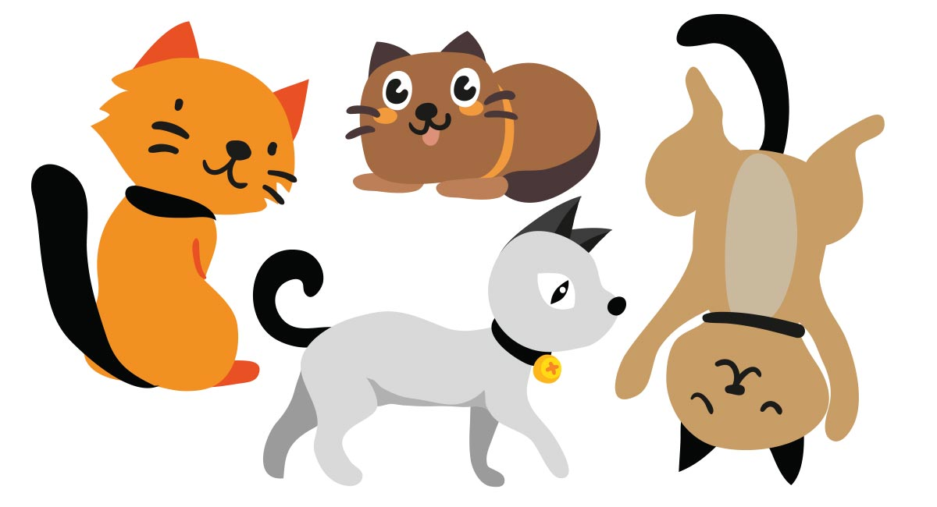
Notes:
Slide 1. Cats: Do you see a picture on the screen? What do you see?
After the child responds and you are sure your screen is visible:
• Now tell me if you see the cats spin around.
After the child responds and you are sure your animation is working:
• This time let me know if you hear some bells when the cats spin around.
After the child responds and you are sure the slide show, animation, and sound are working, begin.

Slide 2
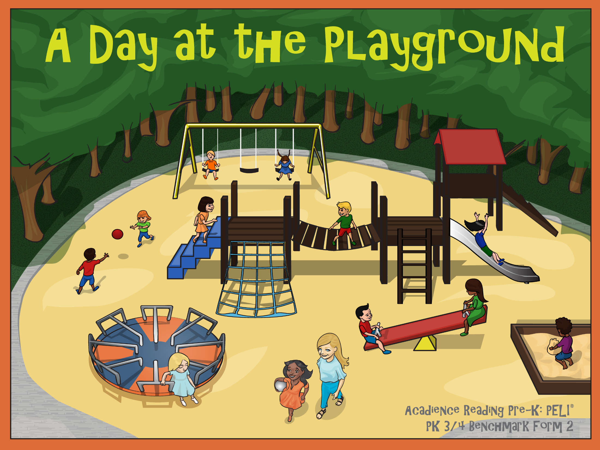
Notes:
Slide 2. Cover: Let’s look at this story together. C1. What do you think this story will be about?
After child responds: This story is called
• A Day at the Playground.

Slide 3
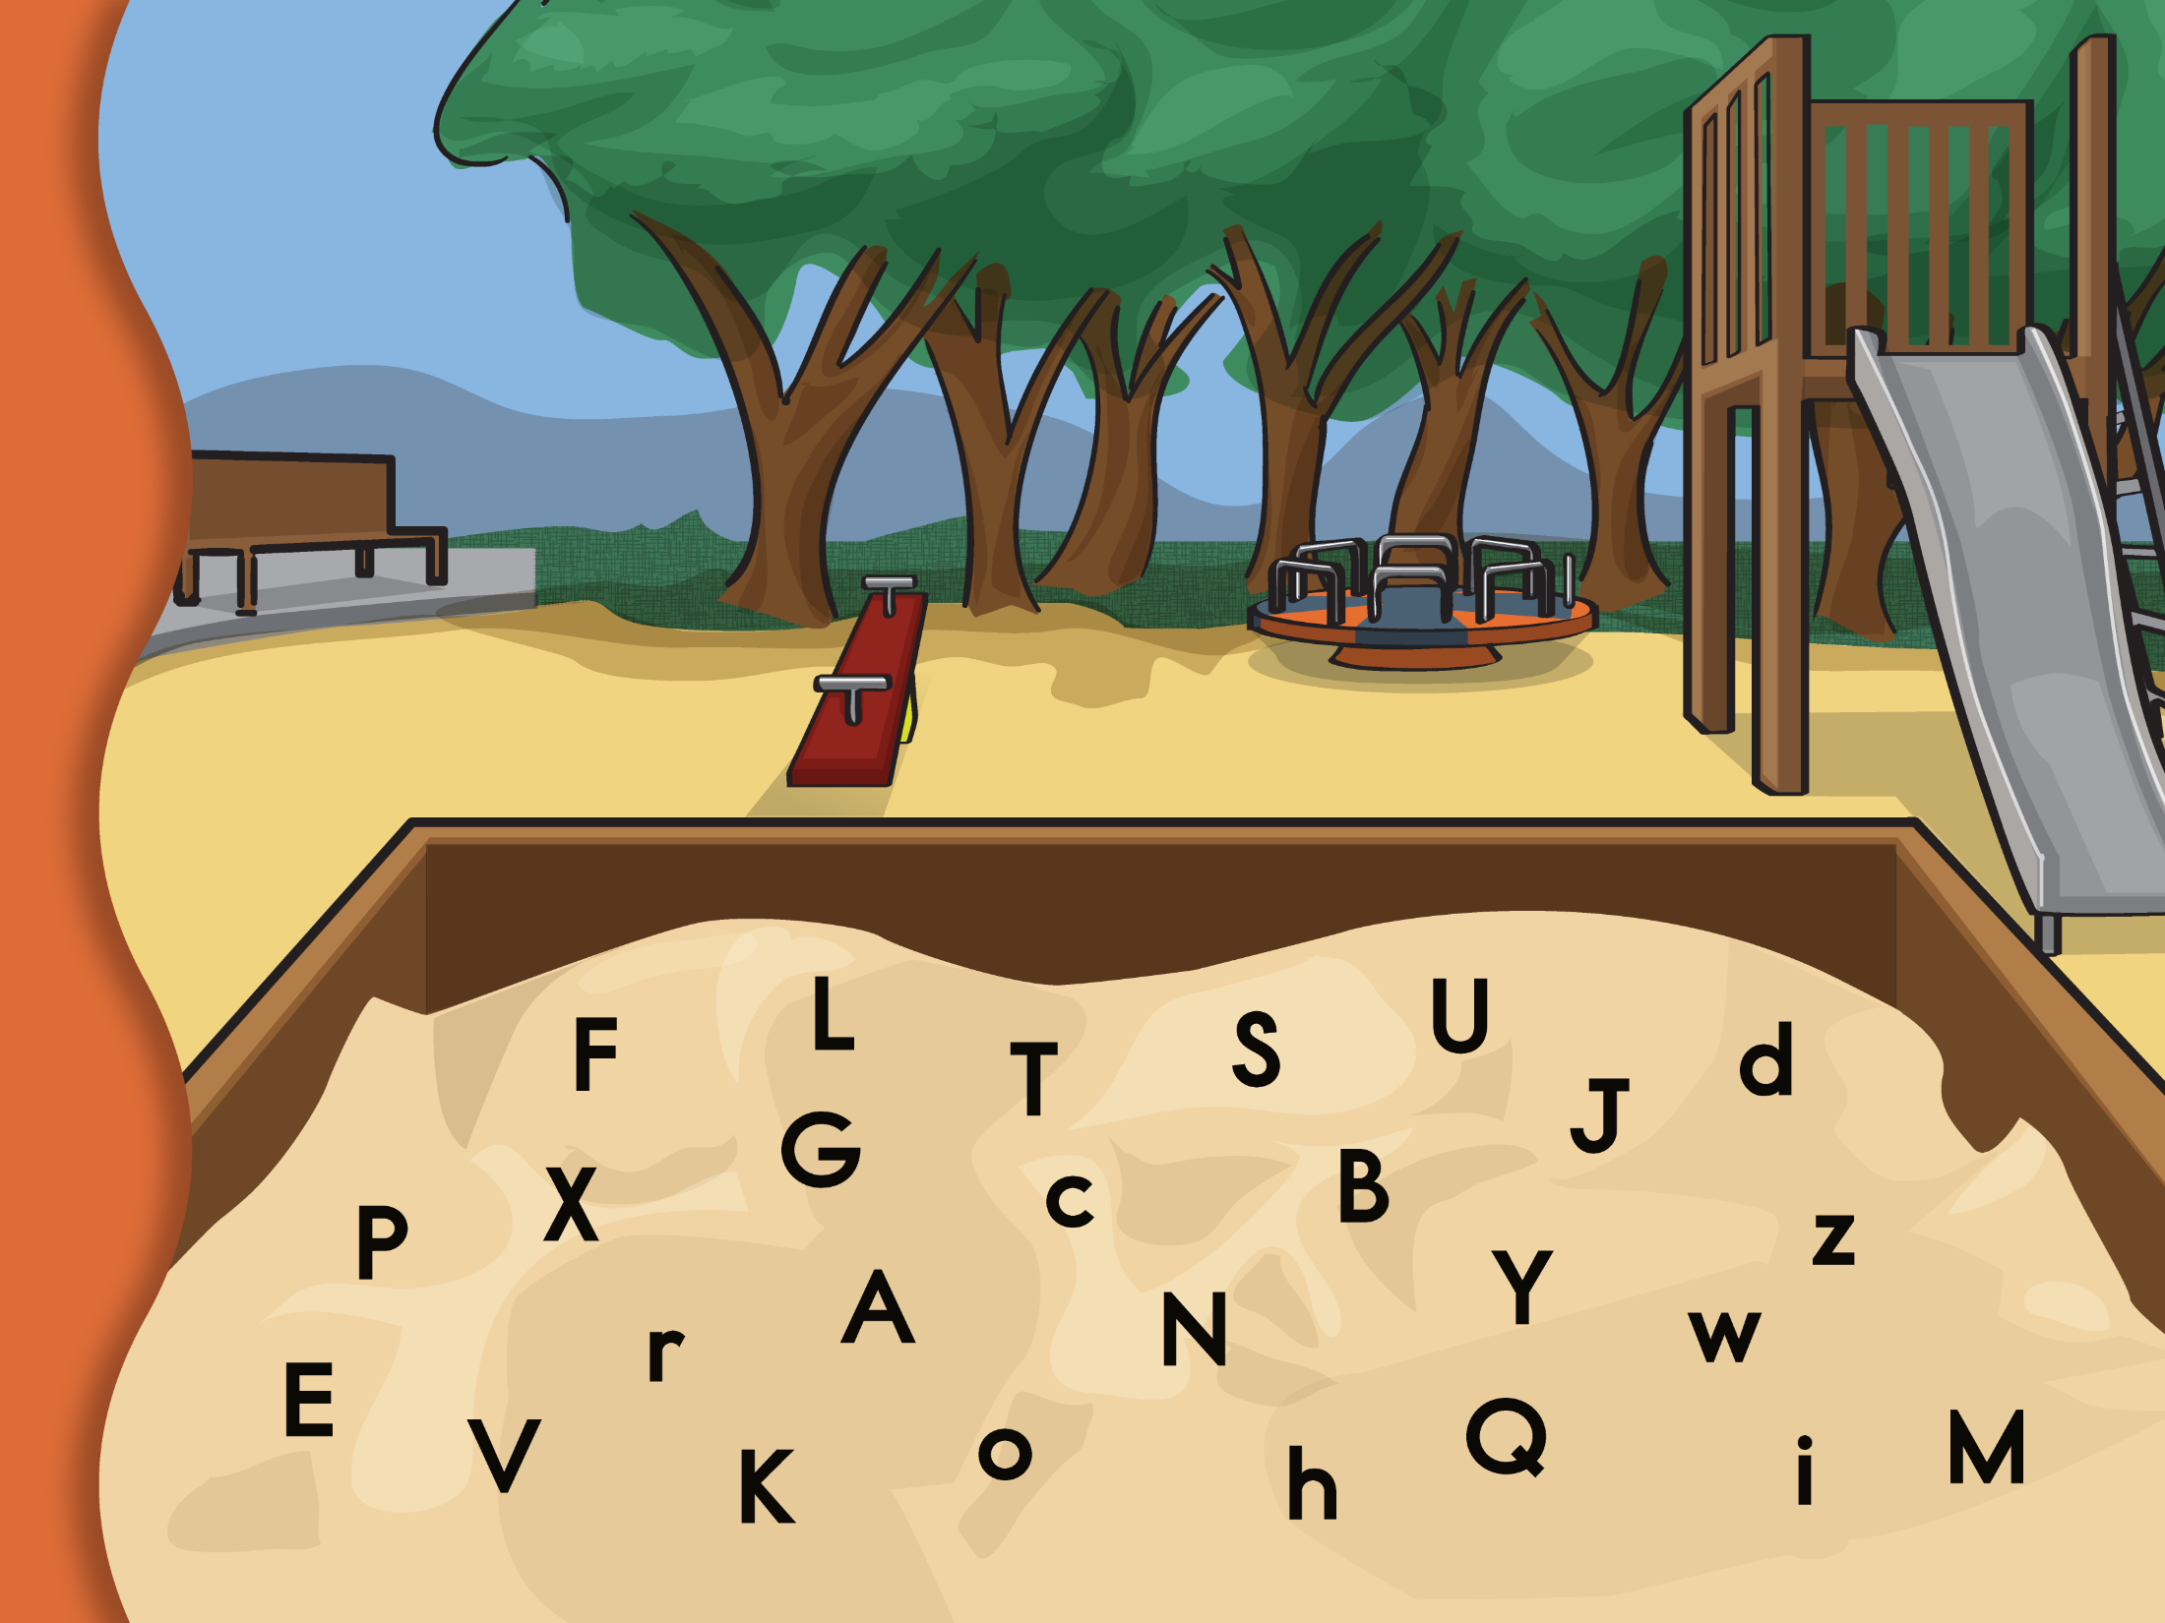
Notes:
Slide 3. AK: Here is a sandbox with letters in it.
• A red box like this, is going to show up around some of the letters in the soup. Click to make the box disappear.
• Watch carefully. When you see a red box, tell me the name of the letter in the box.
Click once to make each box appear and ask, What is this letter? or Do you know what letter this is? Click again to make the box disappear.
Continue until the child names three consecutive letters incorrectly. Then click the arrow in the bottom right corner of the slide to advance to the next page.

Slide 4
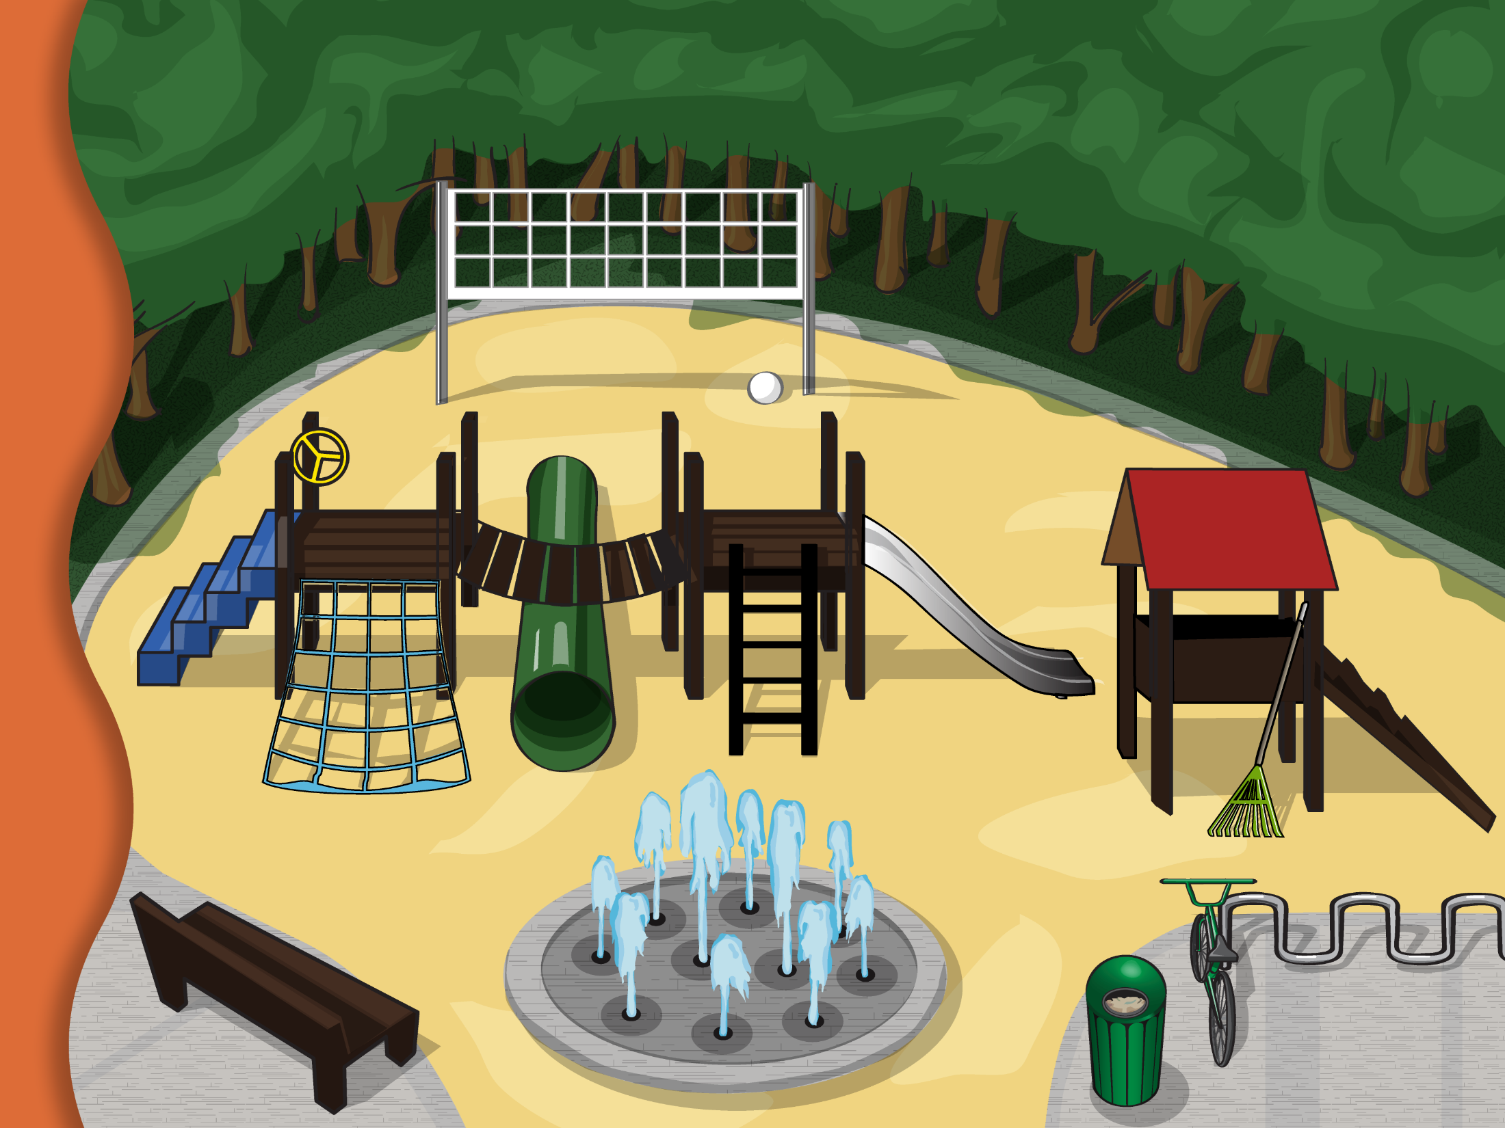
Notes:
Slide 4. V-OL I: Here are some pictures of things you might see on a playground.
• A red circle, like this, is going to show up around some of the things on the playground.
• Watch carefully. When you see the red circle, tell me what is in the circle.
For each picture click and ask, What is this? or Do you know what this is? Click again to make the circle fade.

Slide 5
Notes:
Slide 5. V-OL II. Now I want you to tell me everything you can about some words.
My turn first. I will tell you everything I can about a ladder. (Click and a red circle will appear around the spoon.) A spoon is something you climb up so that you can go down the slide. (Click again and the red circle will fade.)
Now it is your turn. For each word, click and a red circle will appear around the object. Say, Tell me everything you can about (a/an)______. Click again and the red circle will fade. If the child has not named the picture correctly, say, This is a ______ before asking the child to tell you about it.
11. Tell me everything you can about stairs. 12. Tell me everything you can about a garbage can. 13. Tell me everything you can about a bench. 14. Tell me everything you can about a net. 15. Tell me everything you can about bike rack.

Slide 6
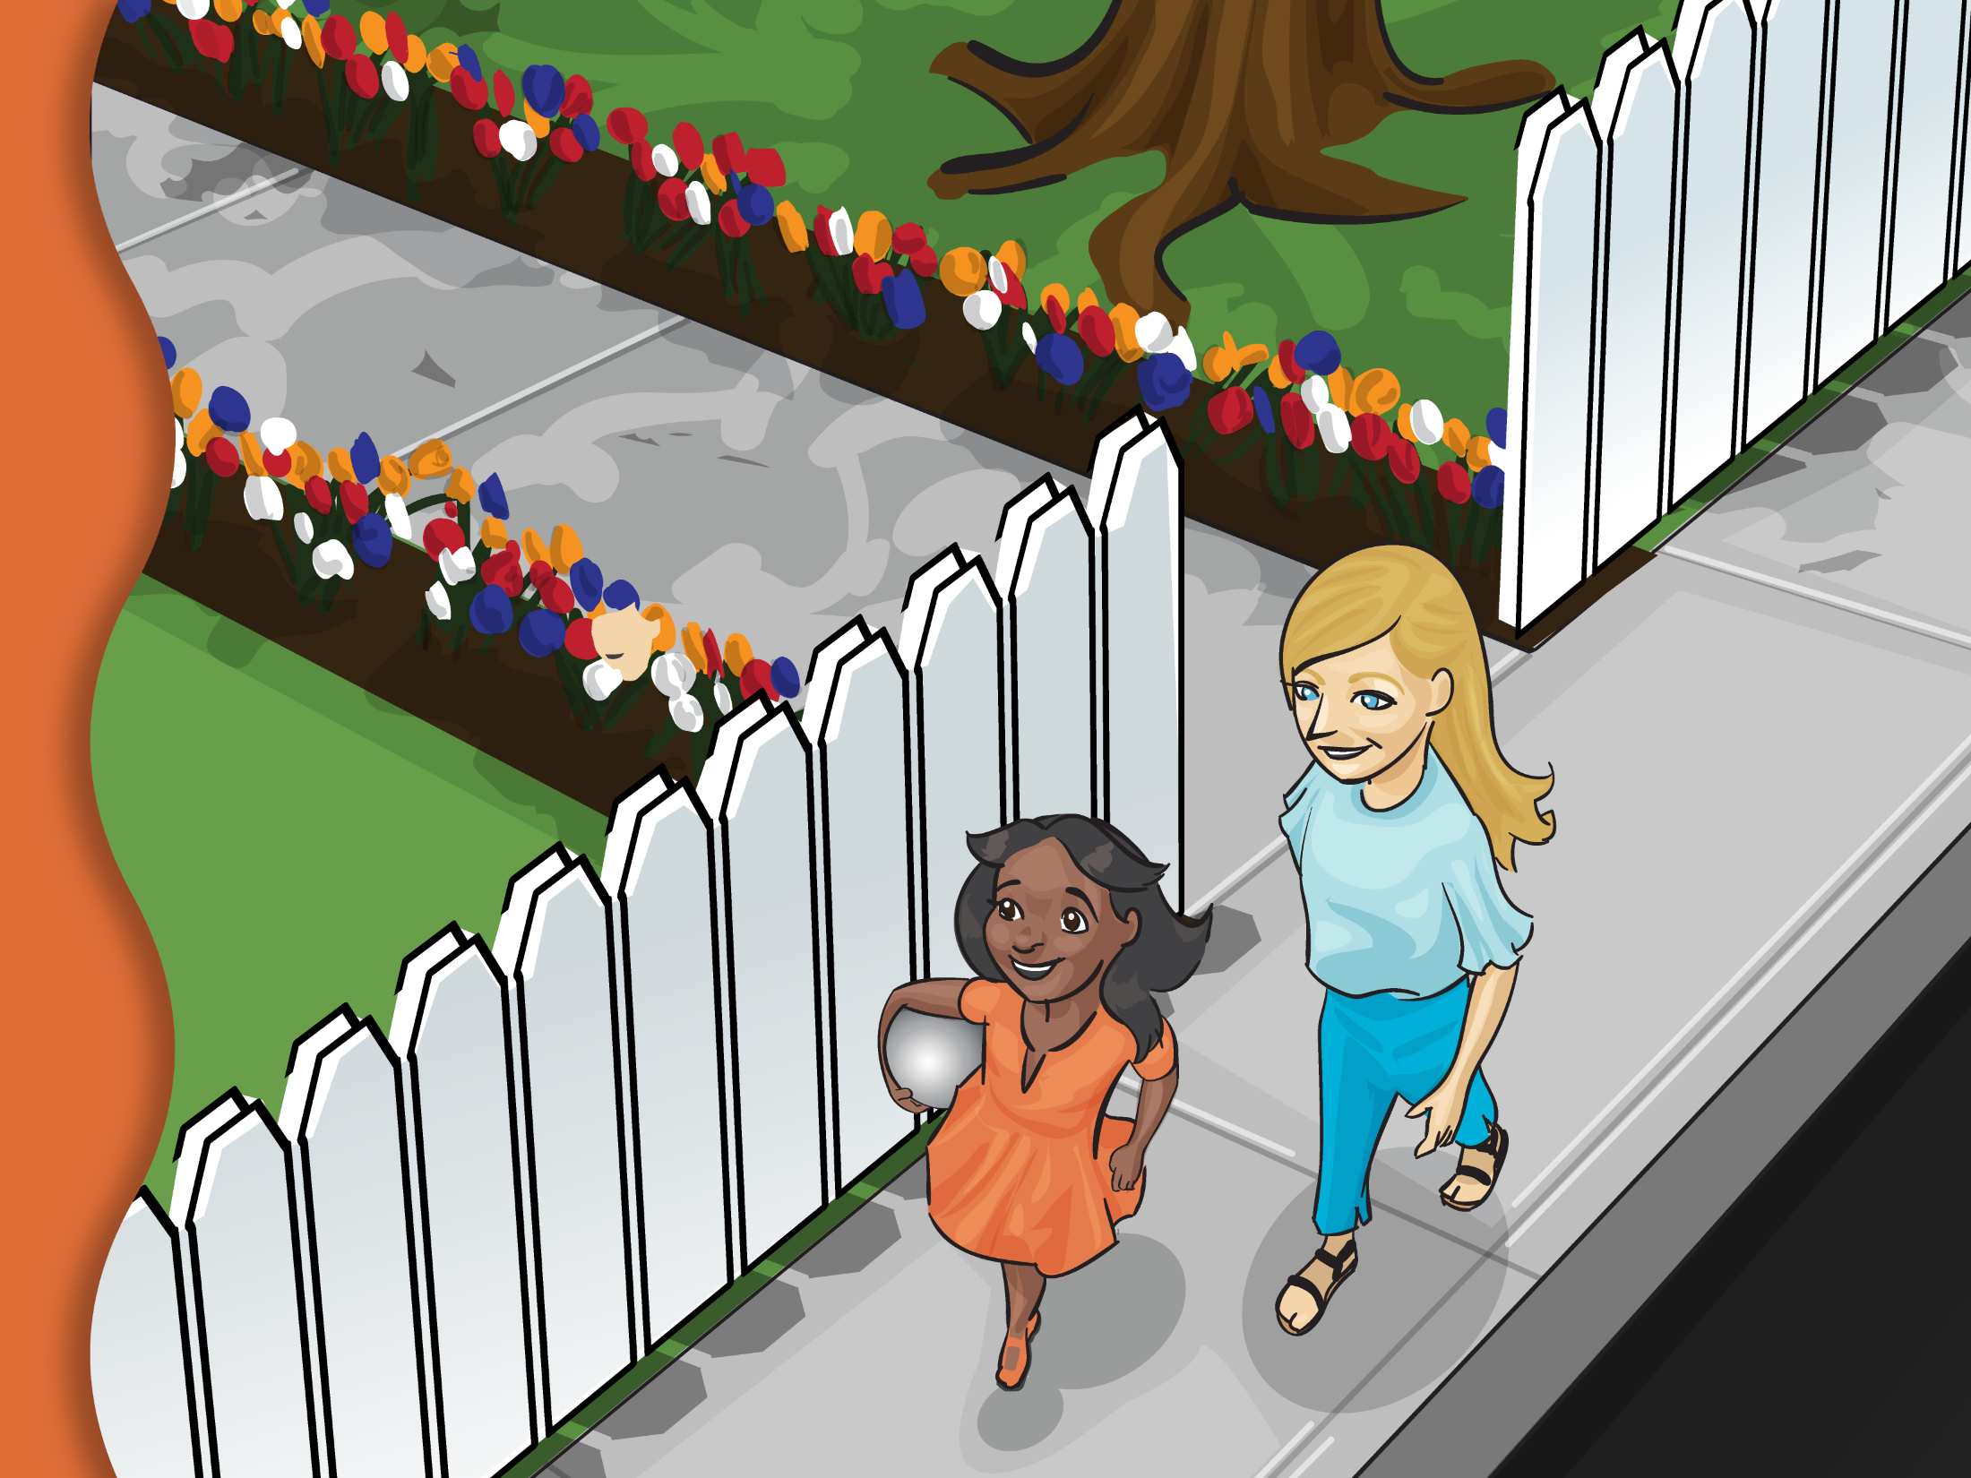
Notes:
Slide 6. Comp: Now I am going to read a story and ask you some questions. This story happens on a warm summer day. Lilly and her babysitter, June, were on their way to the park. They were going to meet Lilly’s friend there. Lilly had a new, shiny silver ball.
C2. What do you think Lilly wants to do at the park?

Slide 7
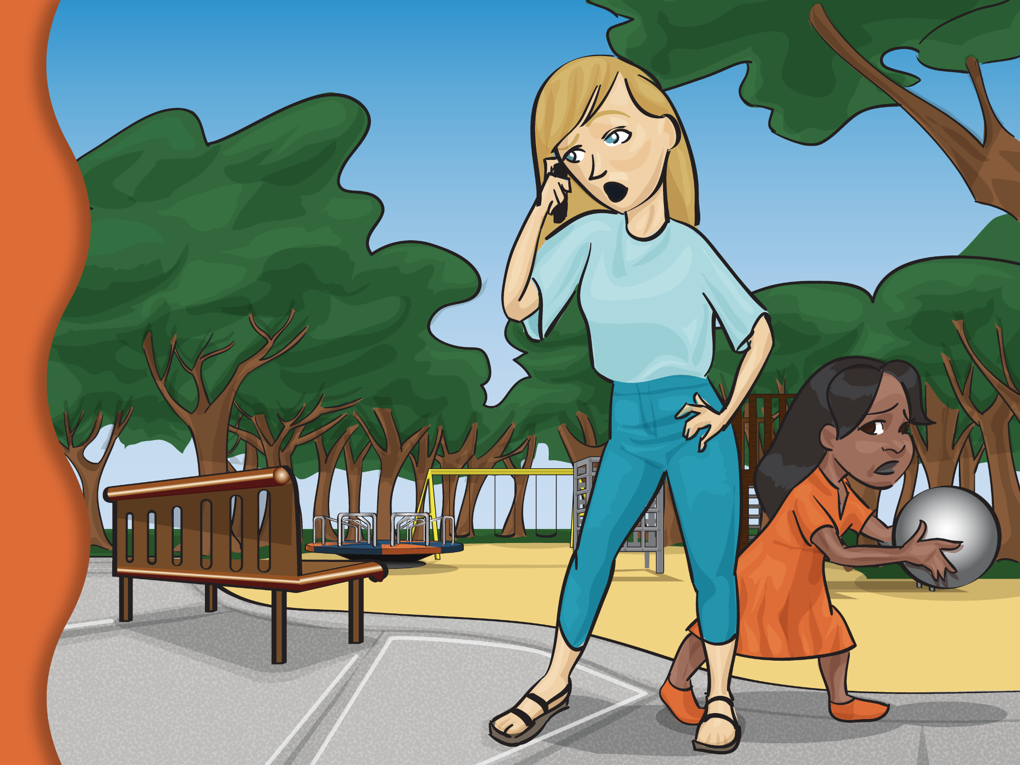
Notes:
Slide 7. Comp: When Lilly and June got to the park, June’s phone rang. “Oh no!” she said. “Your friend is sick.”
C3. How do you think Lilly feels?

Slide 8
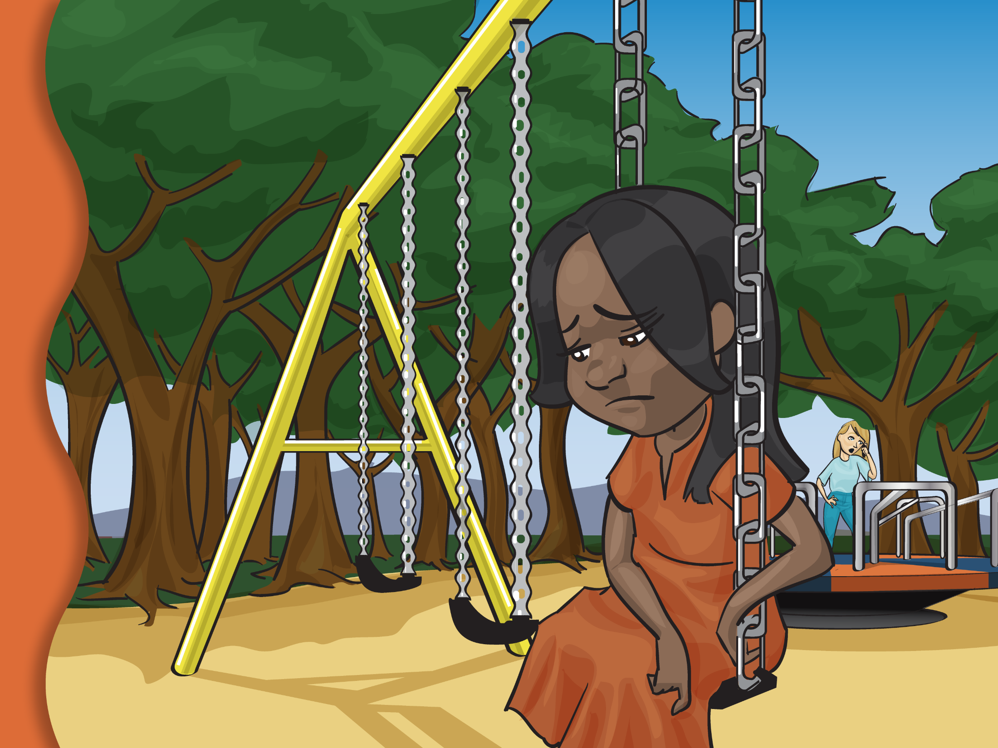
Notes:
Slide 8. Comp: Lilly was sad that her friend was sick. Lilly went to the swing. June asked Lilly if she wanted a push, but Lilly didn’t want to play with June. She wanted to play with a friend her age.

Slide 9
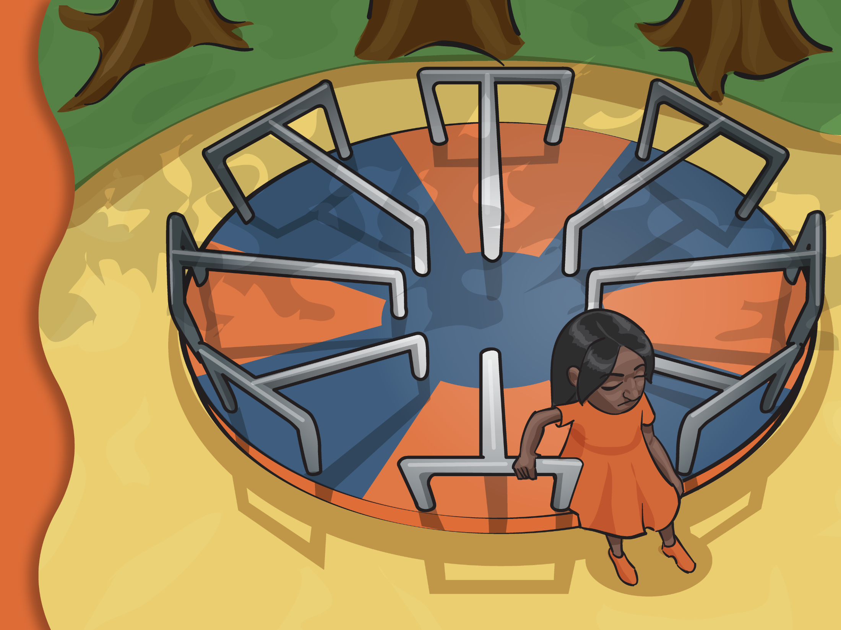
Notes:
Slide 9. Comp. Next Lilly went and sat on the merry-go-round, but she didn’t have a friend to make it spin.

Slide 10
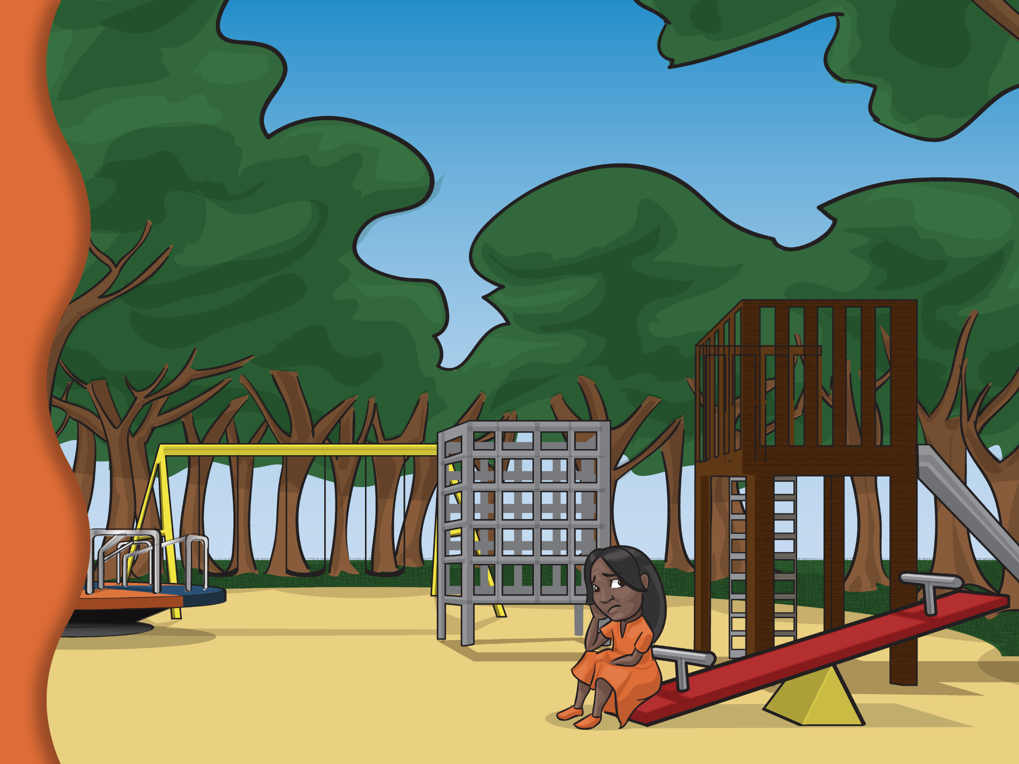
Notes:
Slide 10. Comp. Then Lilly went to the teeter-totter and sat, but without a friend it wouldn’t go up and down. Lilly felt sad. She didn’t want to do anything without a friend.

Slide 11
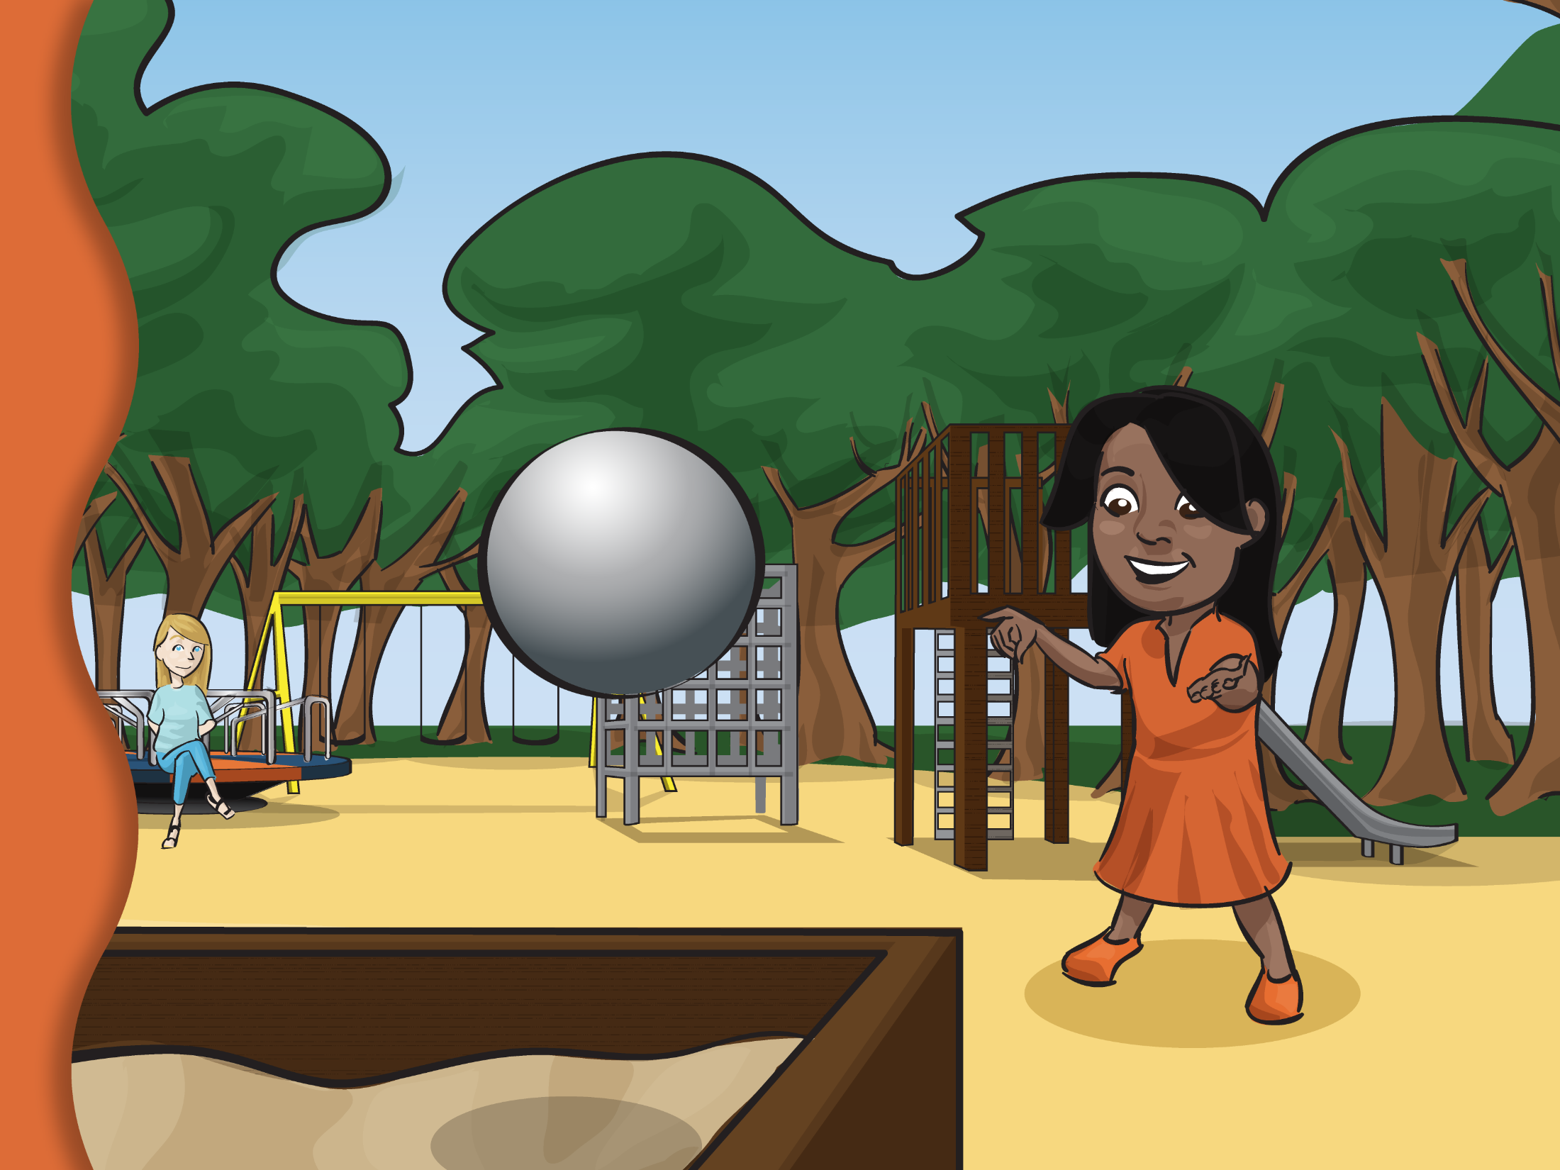
Notes:
Slide 11. Comp. Lilly threw her ball high in the air and watched it land in the sandbox. When she looked at the sandbox, she saw something that made her so happy.
C4. What did Lilly see that made her so happy?

Slide 12
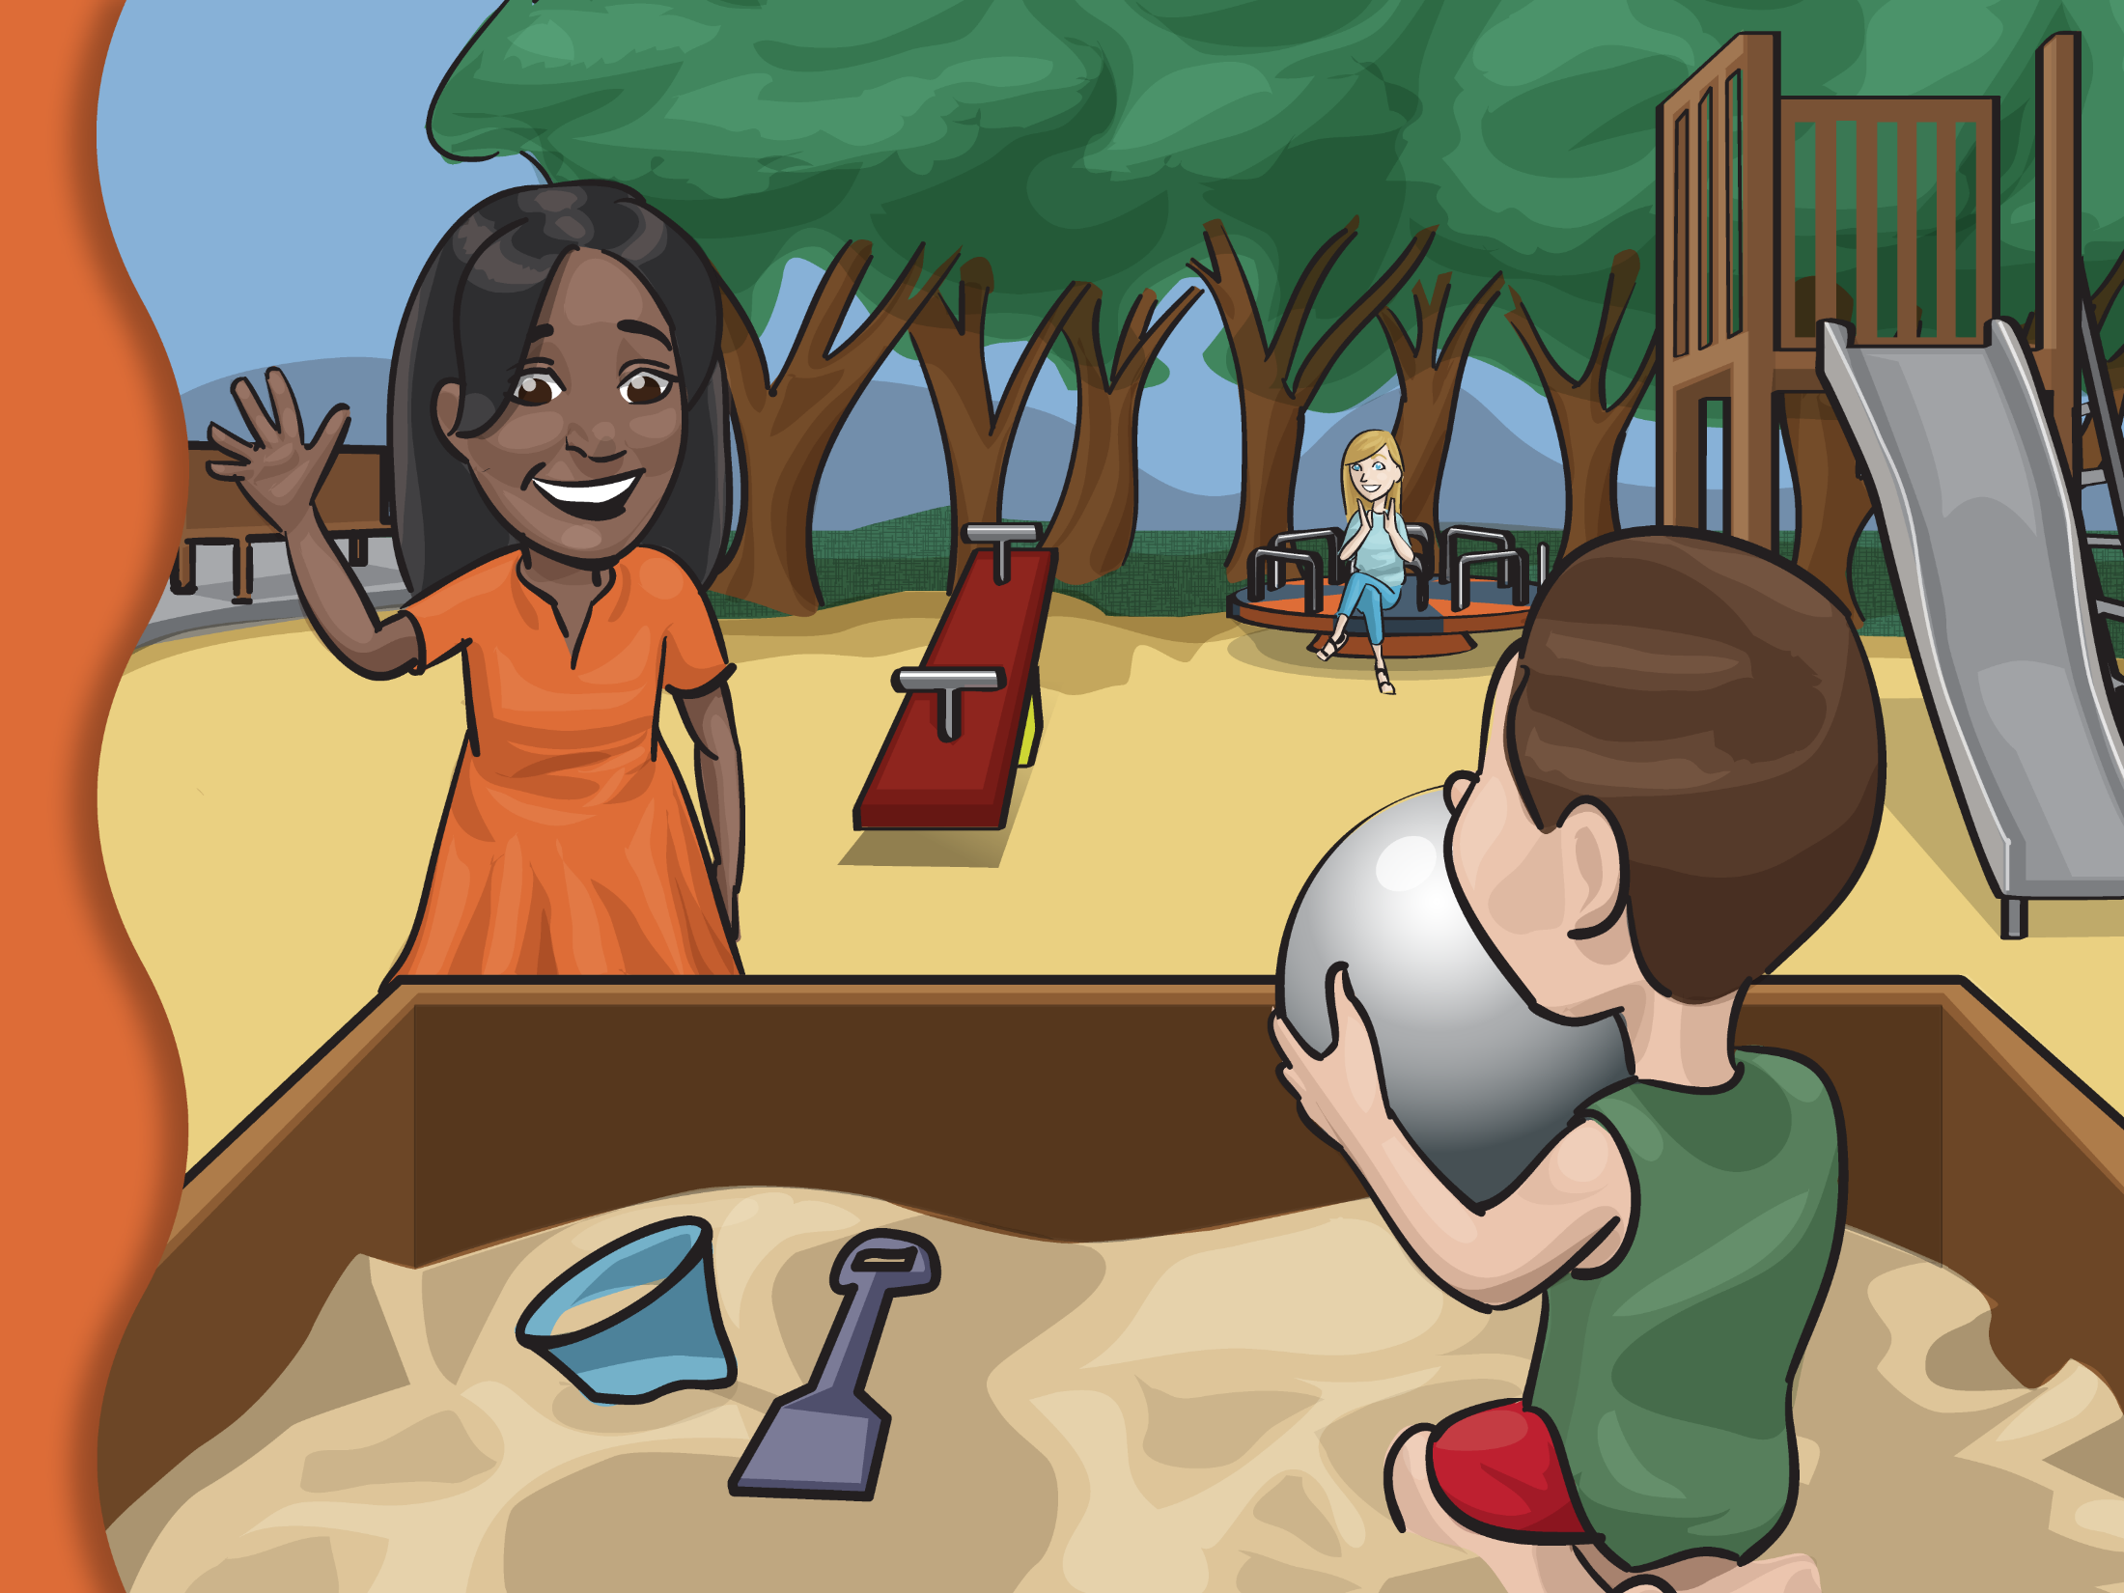
Notes:
Slide 12. Comp: Lilly say a boy in the sandbox! The boy said, “This is a great ball. Can we play with it?”

Slide 13
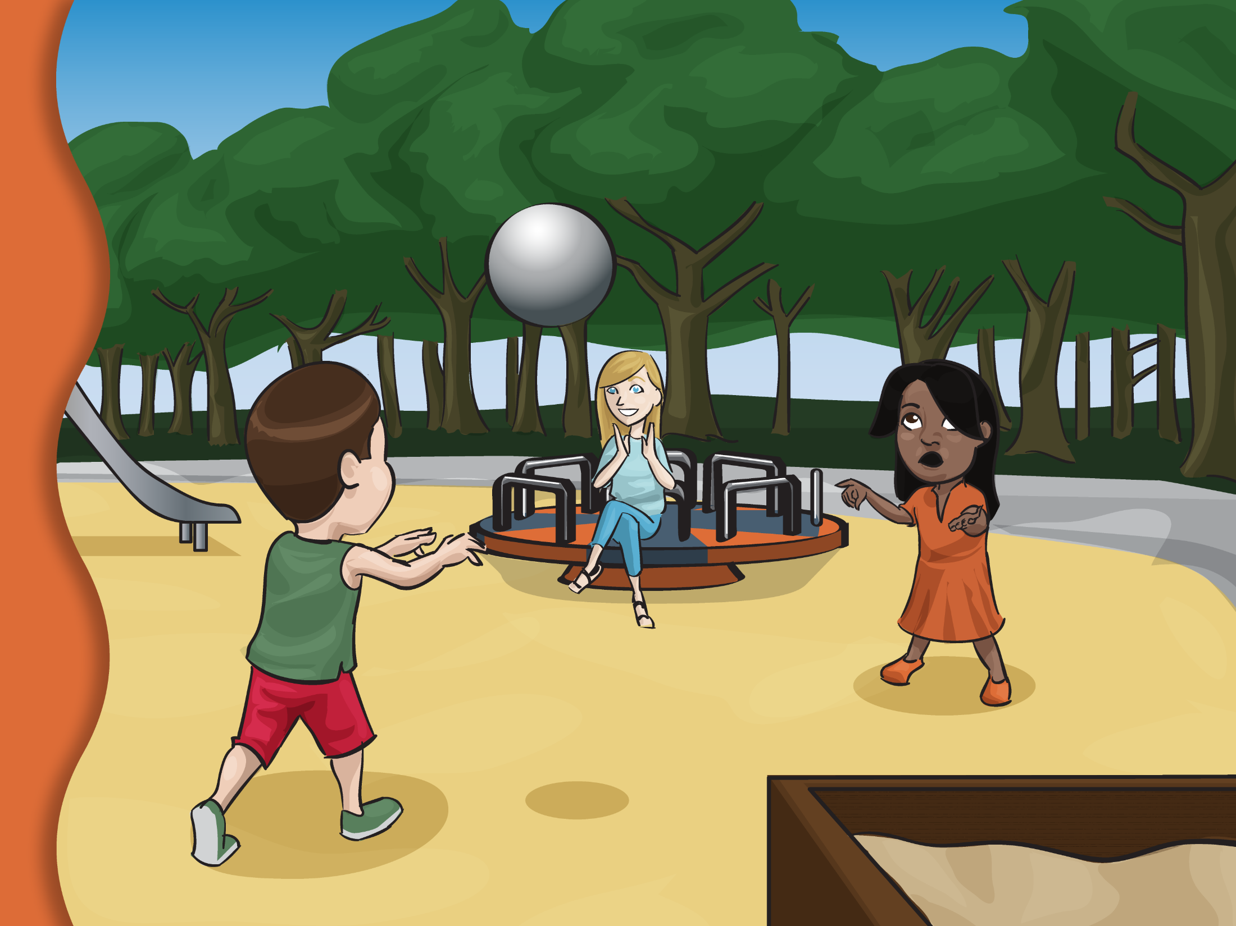
Notes:
Slide 13. Comp: “Yes!” said Lilly, and they played games with the ball until it was time to go home.
Let’s see what you remember about the story.
C5. Who was the story about?
C6. When did the story happen?
C7. Why couldn’t Lilly’s friend come to play with her?
C8. What did Lilly sit on at the park?
C9. Where did Lilly’s ball land when she threw it?

Slide 14
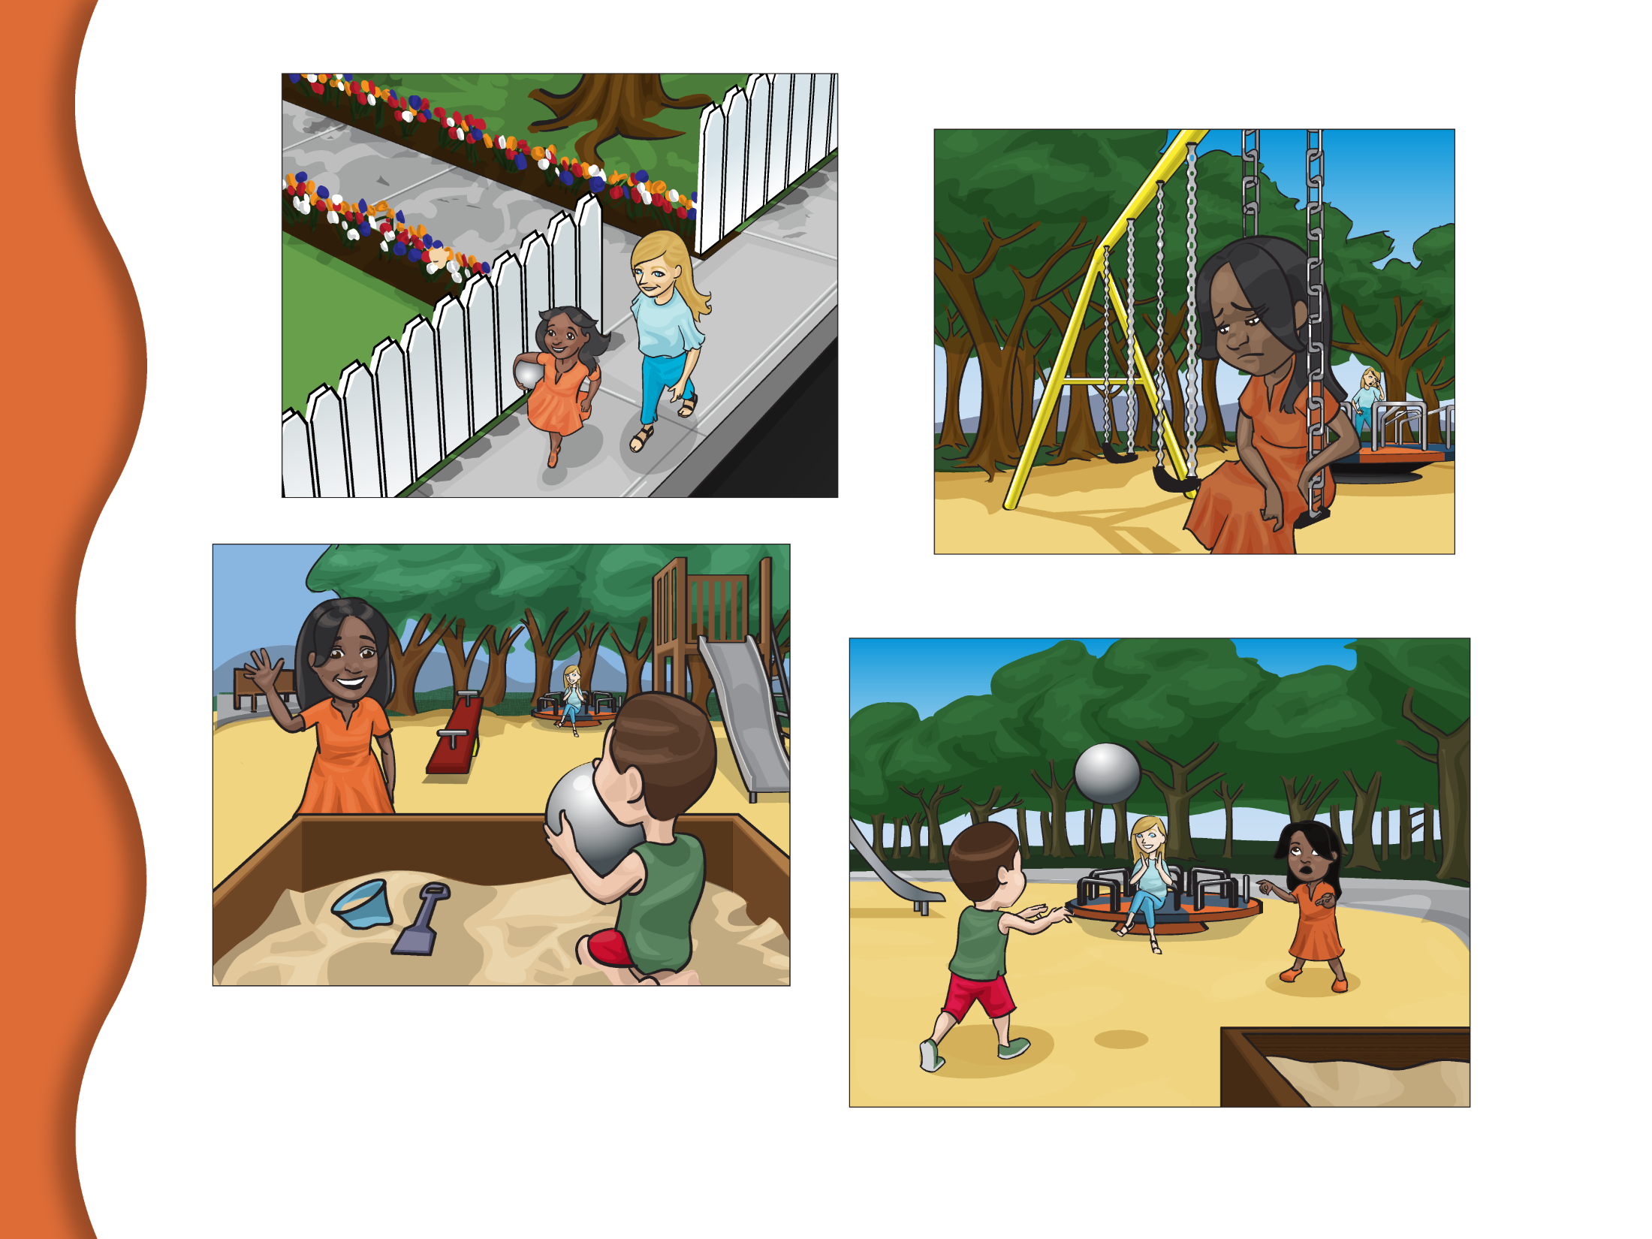
Notes:
Slide 14. Comp: • CII. Here are a few pictures from our story. I am going to read the story again and when I stop, you tell me the words that go in the story.
• Read the text and pause prior to each item to wait for the child’s response.
One day, Lilly and her babysitter walked to the (C10) park.
No response or incorrect response: One day, Lilly and her babysitter walked to the park. For subsequent items, if the child does not respond, say the underlined answer. If the child gives an incorrect response, continue reading.
They were going to meet Lilly’s friend and play with Lilly’s new (C11) ball. Her friend was sick and couldn’t come. Lilly felt (C12) sad. Without a friend there was no one to play with. Lilly threw the ball high in the air and it landed in the sandbox by a (C13) boy. He asked, “Do you want to (C14) play?” Lilly said, “yes,” and they played catch until it was time to go home.

Slide 15
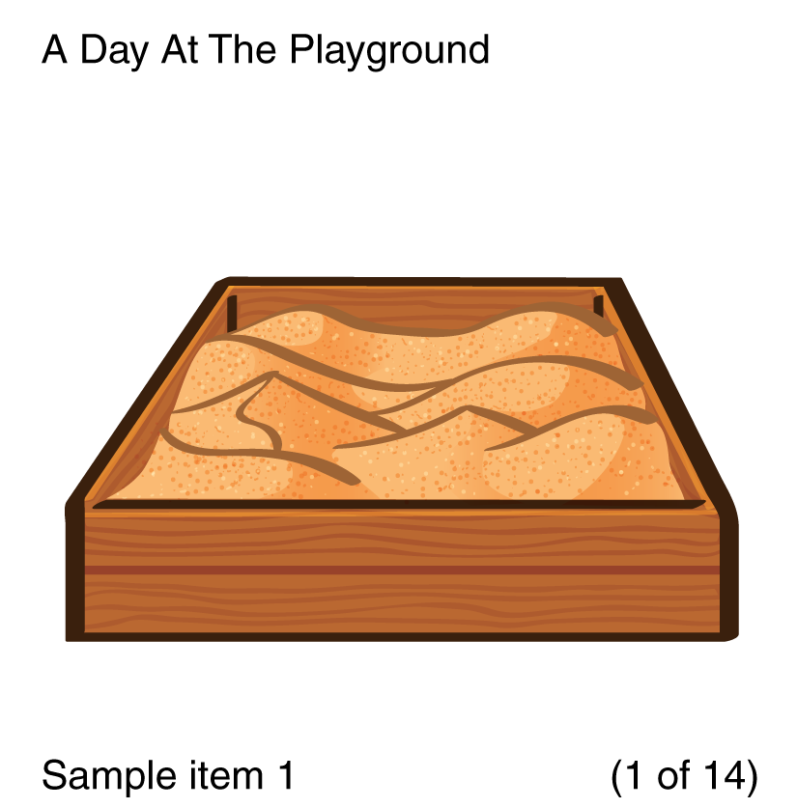
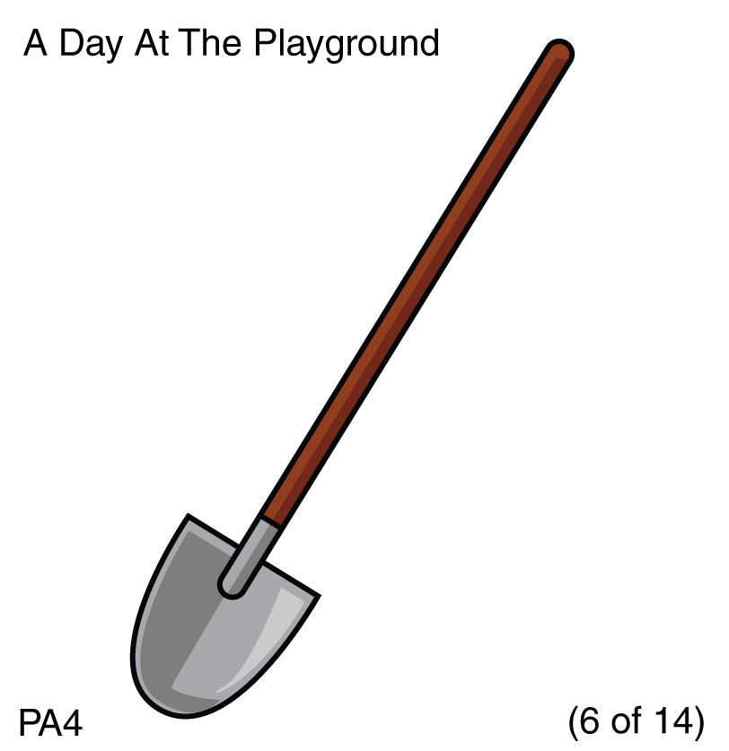
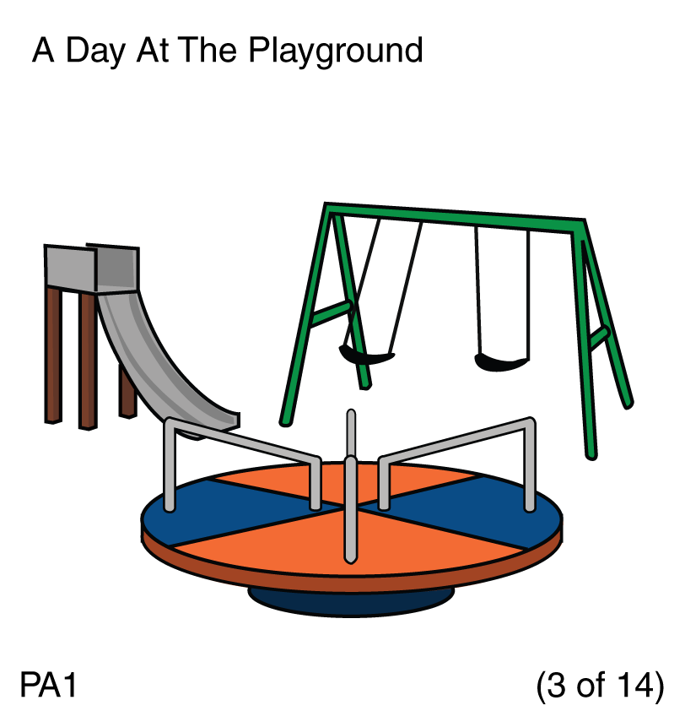
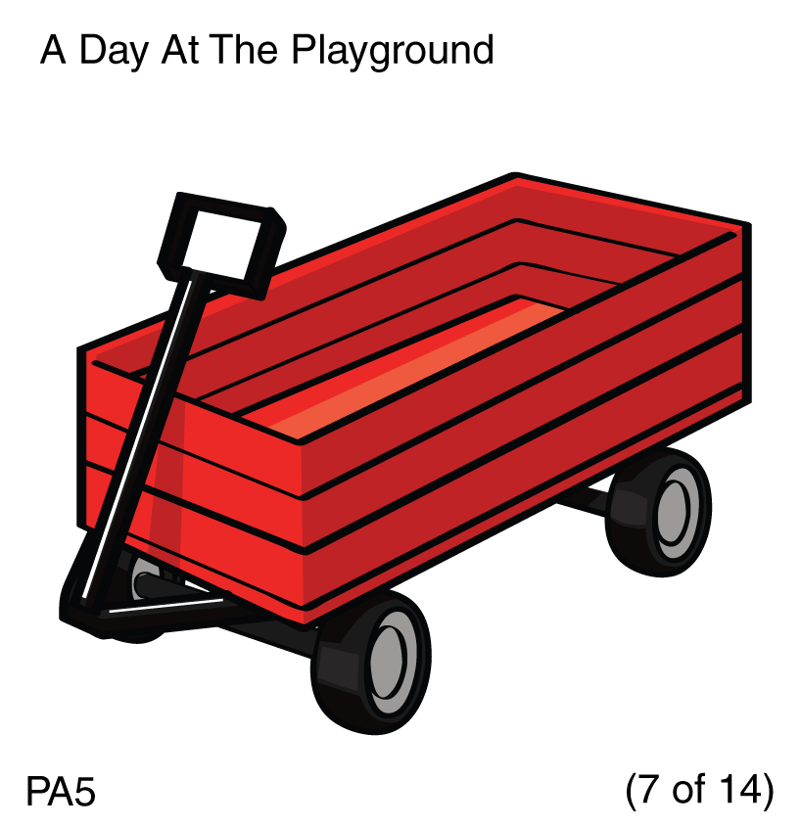
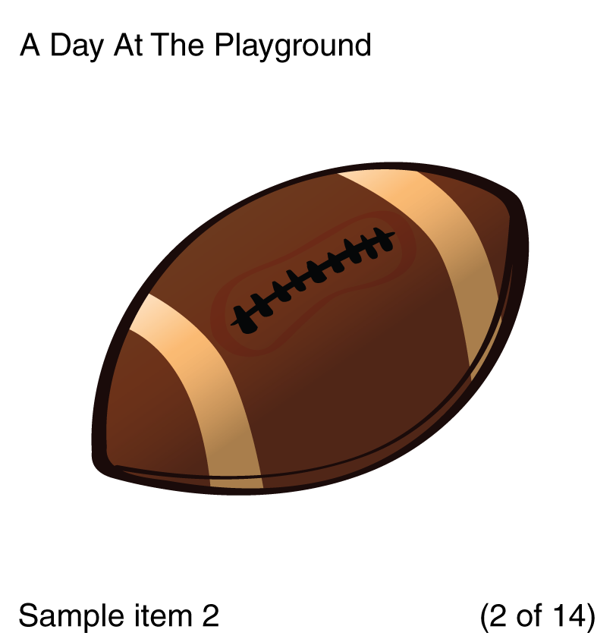
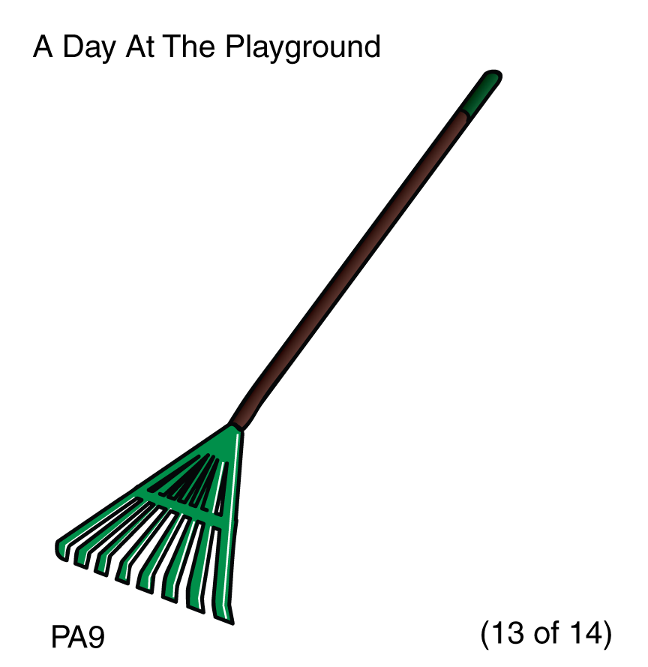
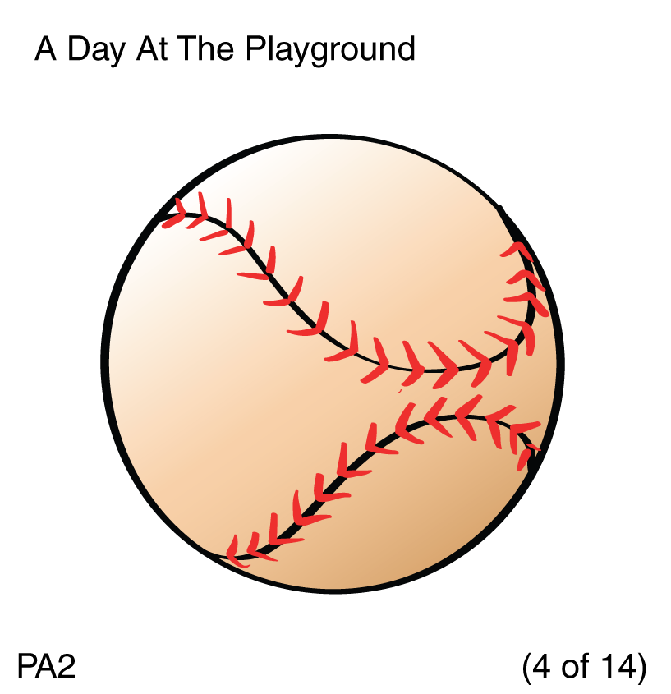
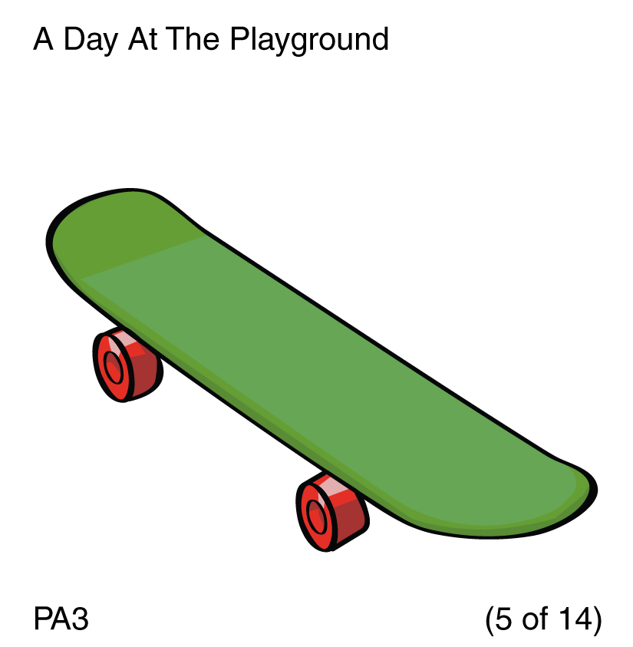
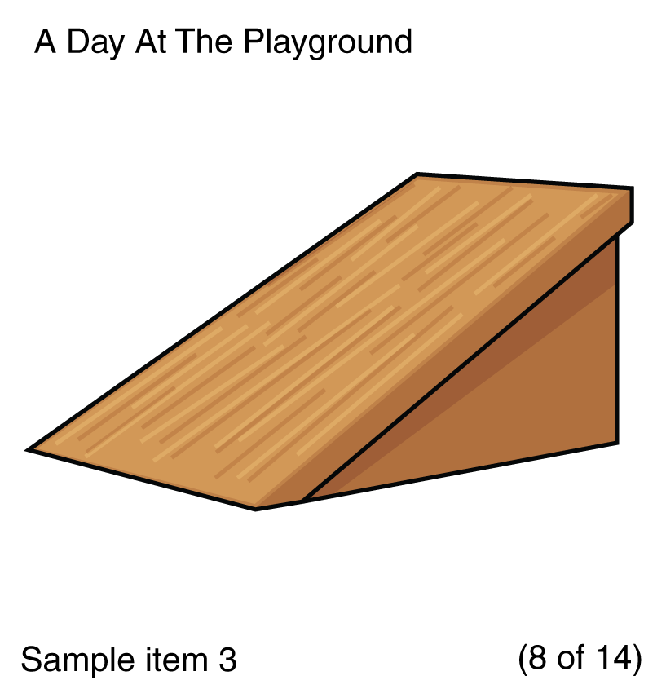
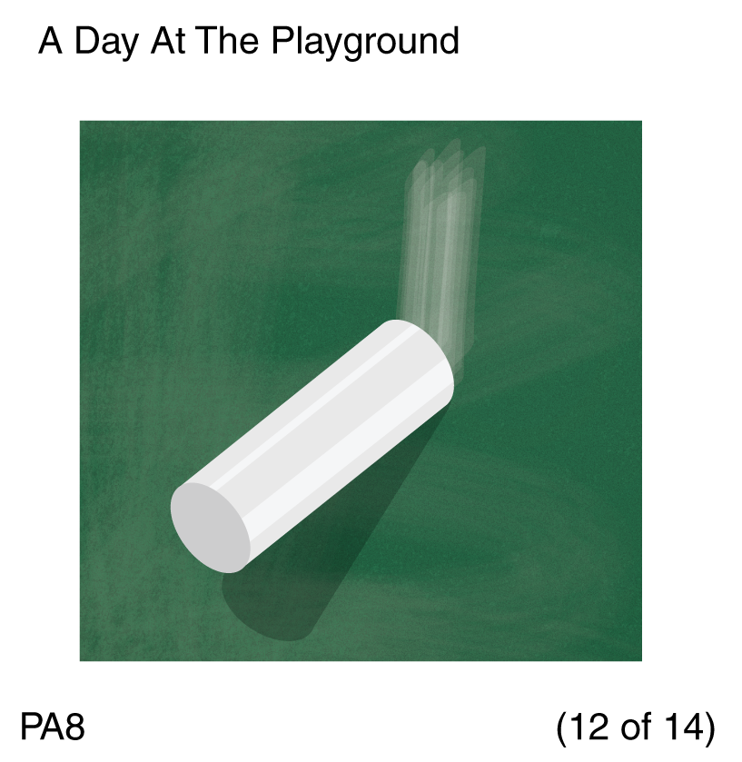
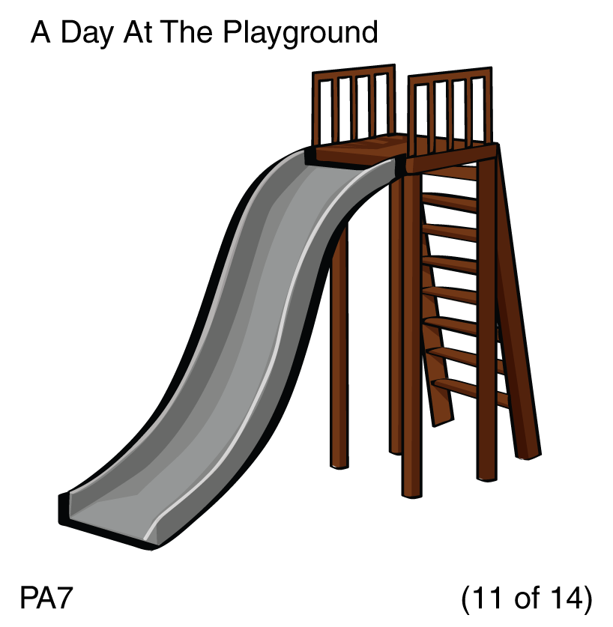
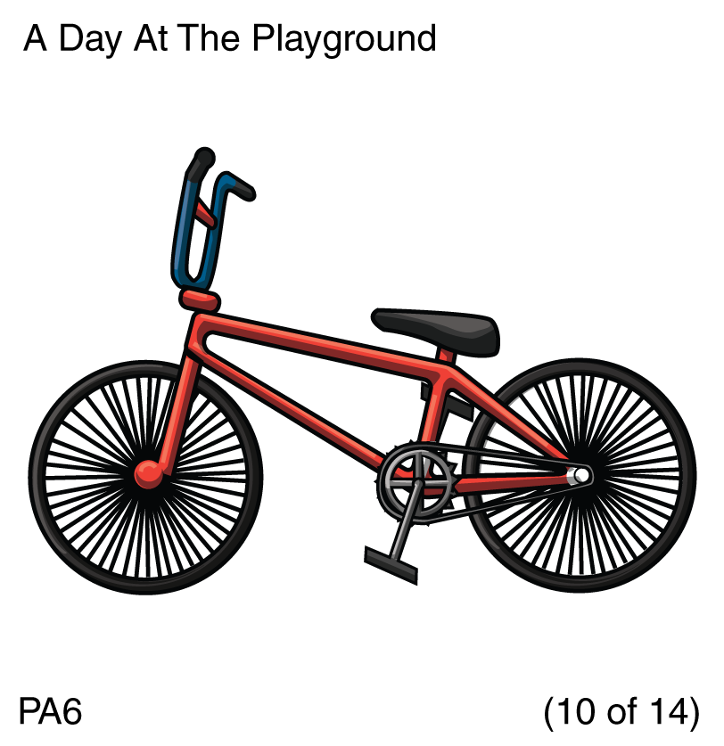
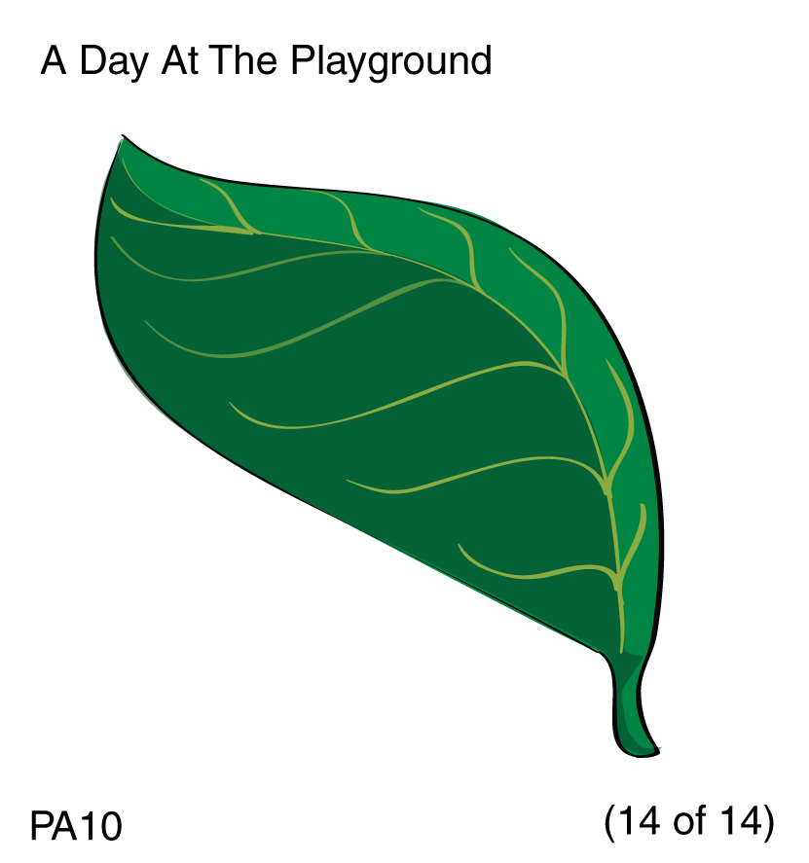
Notes:
Slide 15. PA I Model: Look! Here is a shed at the playground and
• here are some things that go in the shed. Click to make pictures disappear.
• We are going to play a game and put the pictures in the shed. I’m going to show you a picture and say the word and you tell me the first part of the word. Then you can clap your hands and it will go in the shed. My turn first.
• This is a sandbox. The first part of the word “sandbox” is “sand.” “Sand.” “Sandbox.” I said the first part of the word “sandbox,” so clap your hands and it will go into the shed. (Click • to put in cupboard.)

Slide 16
Notes:
Slide 16. PA I Practice: Your turn.
• This is a football. What is the first part of the word “football”?
Child responds correctly : Good! Clap your hands and it will go in the shed. (Click • to put in shed.)
Child responds incorrectly “Foot” is the first part of the word “football.” Say it with me, “foot.” What is the first part of the word “football”?
Correct : Good! Clap your hands and it will go in the shed. (Click • to put in shed.)
Incorrect: “Foot” is the first part of the word “football.” Say “foot.” Clap your hands and it will go in the shed. (Click • to put in shed.)

Slide 17
Notes:
Slide 17. PA I Test Items:
For each item, click to make the picture appear. After the child responds, have the child clap, then click to put it in the shed.
PA1. This is a playground. What is the first part of the word “playground”? (After child responds, click • to put in shed.)
PA2. This is a softball. What is the first part of the word “softball”? (After child responds, click • to put in shed.)
PA3. This is a skateboard. What is the first part of the word “skateboard”? (After child responds, click • to put in shed.)
PA4. This is a shovel. What is the first part of the word “shovel”? (After child responds, click • to put in shed.)
PA5. This is a wagon. What is the first part of the word “wagon”? (After child responds, click • to put in shed.)
Optional for 3/4s: If the child does not respond to any items in Part I correctly, you may discontinue the task. Record a 0 for both Part I and Part II.

Slide 18
Notes:
Slide 18. PA II Model:
I have some other things that go in the cupboard. This time I want you to tell me the first sound in the word. My turn first.
• This is a ramp. The first sound in the word “ramp” is /r/. /r/, ramp. I said the first sound in the word “ramp,”
• so clap your hands and it will go into the shed.

Slide 19
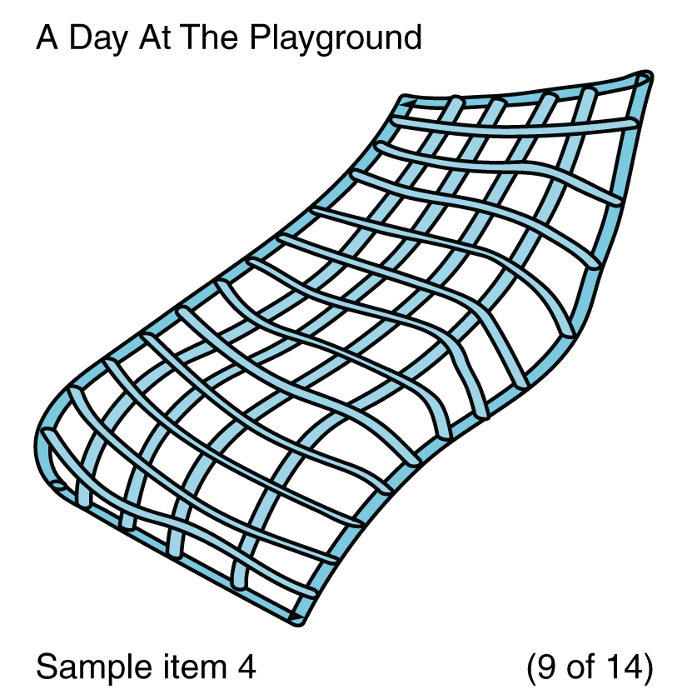
Notes:
Slide 19. PA II Practice: Your turn.
This is a net. What is the first sound in the word “net”?
Child responds correctly: Good! Clap your hands and it will go in the shed. (Click • to put in shed.)
Child responds incorrectly: The first sound in the word “net” is /n/. Say it with me, /n/. What is the first sound in the word “net”?
Correct: Good! Clap your hands and it will go in the shed. (Click • to put in shed.)
Incorrect : /n/ is the first sound in the word “net.” Say“/n/.” Clap your hands and it will go in the shed. (Click • to put in shed.)

Slide 20
Notes:
Slide 20. PA II Test Items:
PA6. • This is bread. What is the first sound in the word “bread”? (After child responds, click • to put in cupboard.)
PA7. • This is a fork. What is the first sound in the word “fork”? (After child responds, click • to put in cupboard.)
PA8. • This is a lime. What is the first sound in the word “lime”? (After child responds, click • to put in cupboard.)
PA9. • This is jam. What is the first sound in the word “jam”? (After child responds, click • to put in cupboard.)
PA10. • This is a dish. What is the first sound in the word “dish”? (After child responds, click • to put in cupboard.)

Slide 21
THE END!
THANK YOU!
Notes:
Slide 21. Cats: That is the end! We are all done.
• Thank you!

